Slide 1
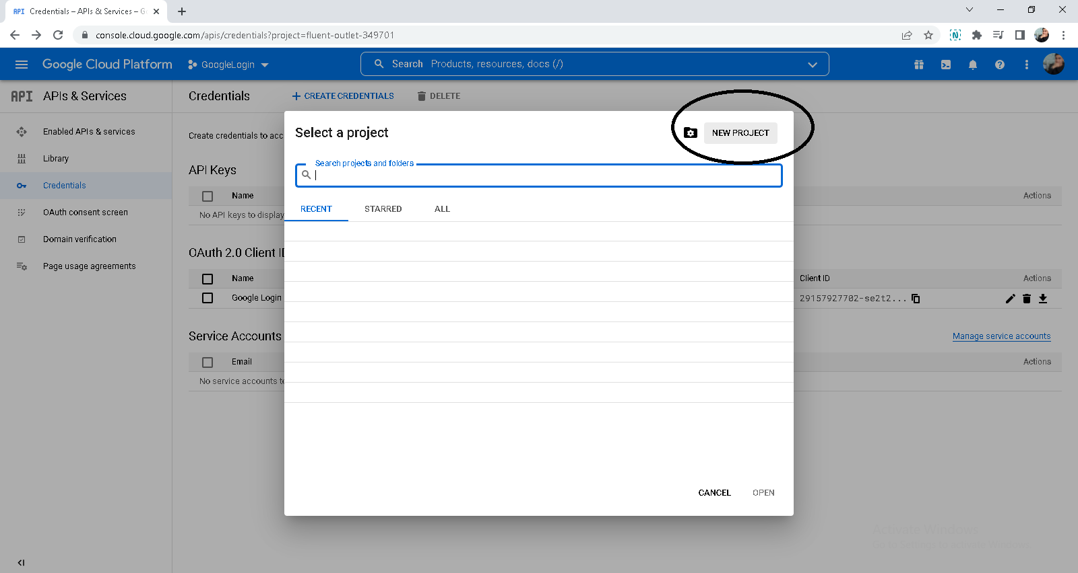
https://console.cloud.google.com/

Slide 2
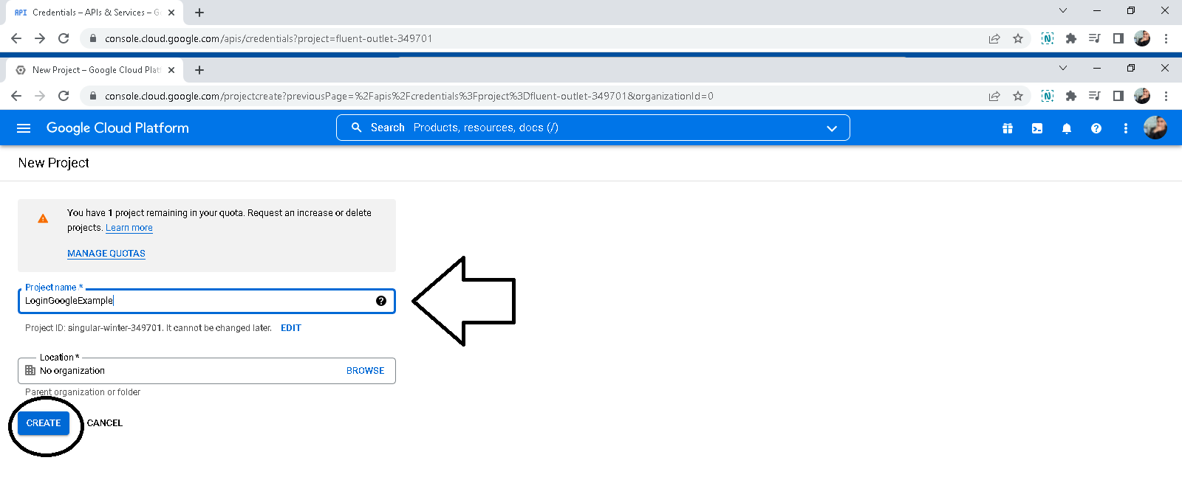

Slide 3
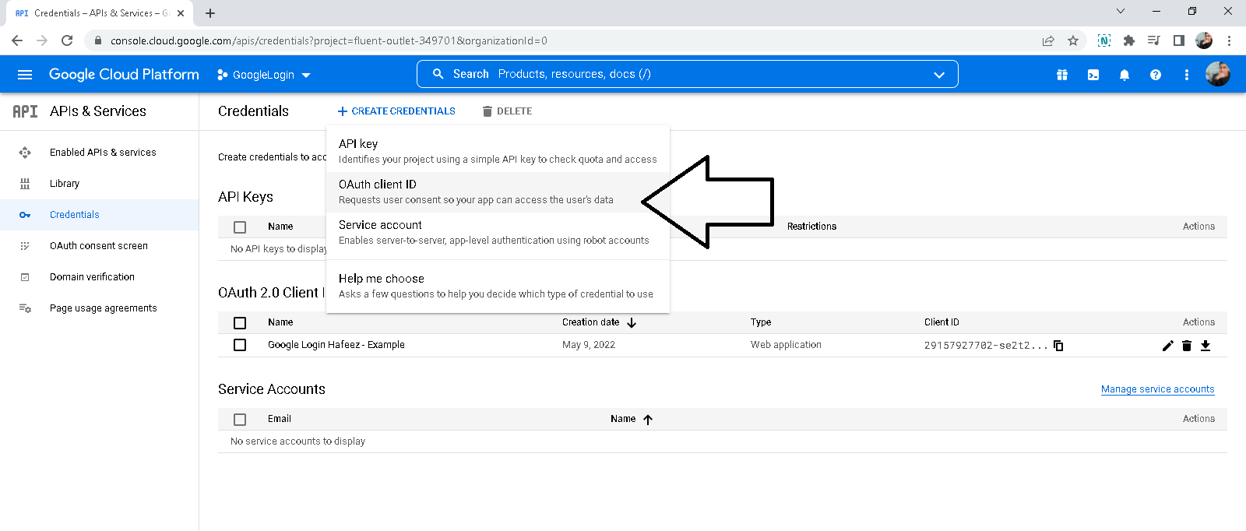

Slide 4
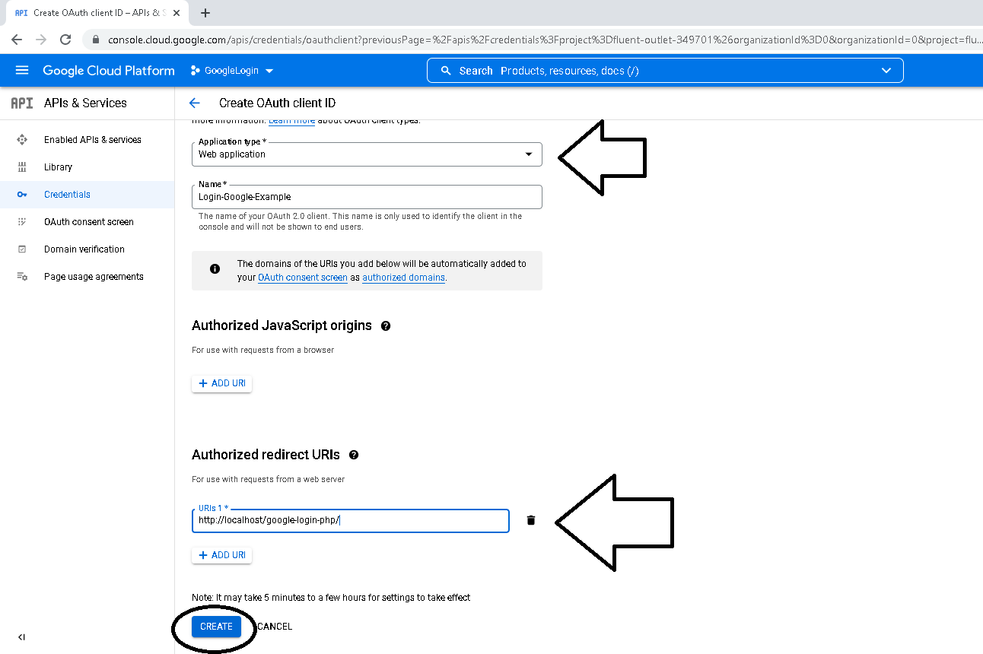

Slide 5
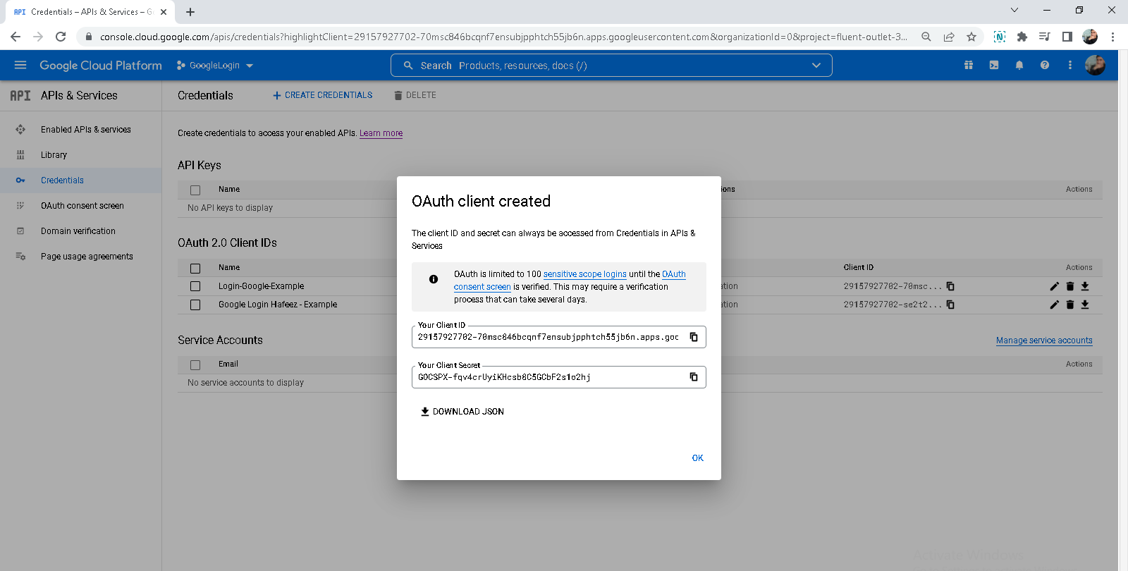

Slide 6
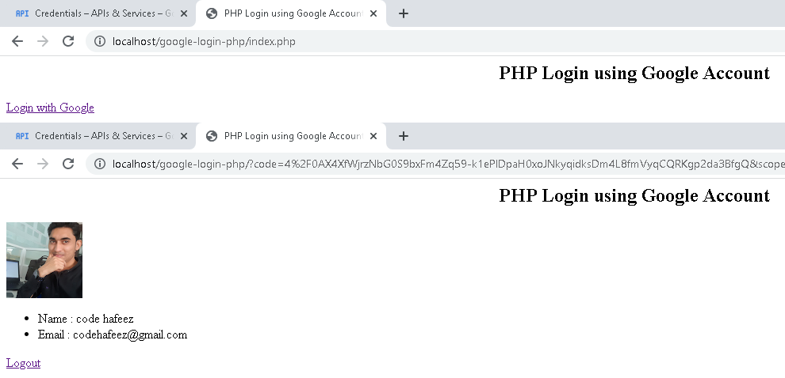
// index.php
<?php
include('config.php');
if(isset($_GET["code"])){
$token = $google_client->fetchAccessTokenWithAuthCode($_GET["code"]);
if(!isset($token['error'])){
$google_client->setAccessToken($token['access_token']);
$_SESSION['access_token']=$token['access_token'];
$google_service = new Google_Service_Oauth2($google_client);
$data = $google_service->userinfo->get();
$_SESSION['user_email_address'] =$data['email'];
$_SESSION['user_first_name'] =$data['given_name'];
$_SESSION['user_last_name'] = $data['family_name'];
$_SESSION['user_picture'] = $data['picture'];
}
}
?>
<html>
<head>
<title>PHP Login using Google Account</title>
</head>
<body>
<h2 align="center">PHP Login using Google Account</h2>
<?php
if(isset($_SESSION['user_email_address'])){ ?>
<img src="<?=$_SESSION['user_picture']?>">
<ul>
<li>Name : <?=$_SESSION['user_first_name']?> <?=$_SESSION['user_last_name']?></li>
<li>Email : <?=$_SESSION['user_email_address']?> </li>
</ul>
<a href="logout.php">Logout</a>
<?php } else { ?>
<a href="<?=$google_client->createAuthUrl()?>">Login with Google</a>
<?php } ?>
</body>
</html>
// config.php
<?php
require_once('vendor/autoload.php');
$google_client = new Google_Client();
$google_client->setClientId('29157927702-se2t2kf01ct4hiovmrgfv6u7imlp3c5o.apps.googleusercontent.com');
$google_client->setClientSecret('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');
$google_client->setRedirectUri('http://localhost/google-login-php');
$google_client->addScope('email');
$google_client->addScope('profile');
session_start();
?>
// logout.php
<?php
include('config.php');
$google_client->revokeToken();
session_destroy();
header('location:index.php');
?>

